Slide 1
Final Project BDAT 1001
Information Encoding Standards
Instructor: Nital Shah
Georgian College

Slide 2
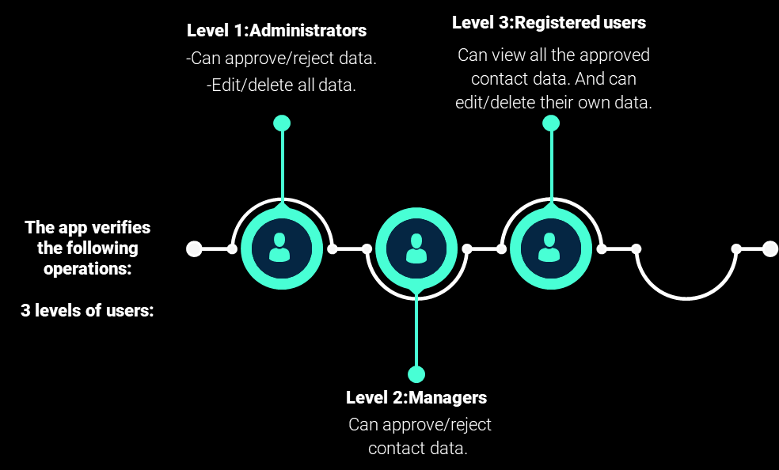
Project Summary
ASP.NET Core web application with user data protected by authorization
Security Technologies Recommendations
Part 1
Part 2

Slide 3
Team Profile
Edith de la Cruz Rubianes
Samantha Chibiya
Monica Cubas
Bachelor's Degree in System Engineering
(Lima-Peru)
Bachelor's Degree in Finance.
Bachelor's Degree in System Engineering
(Honduras)

Slide 4
ASP.NET
Part 1 : Demonstration User Data Protected by authorization

Slide 5
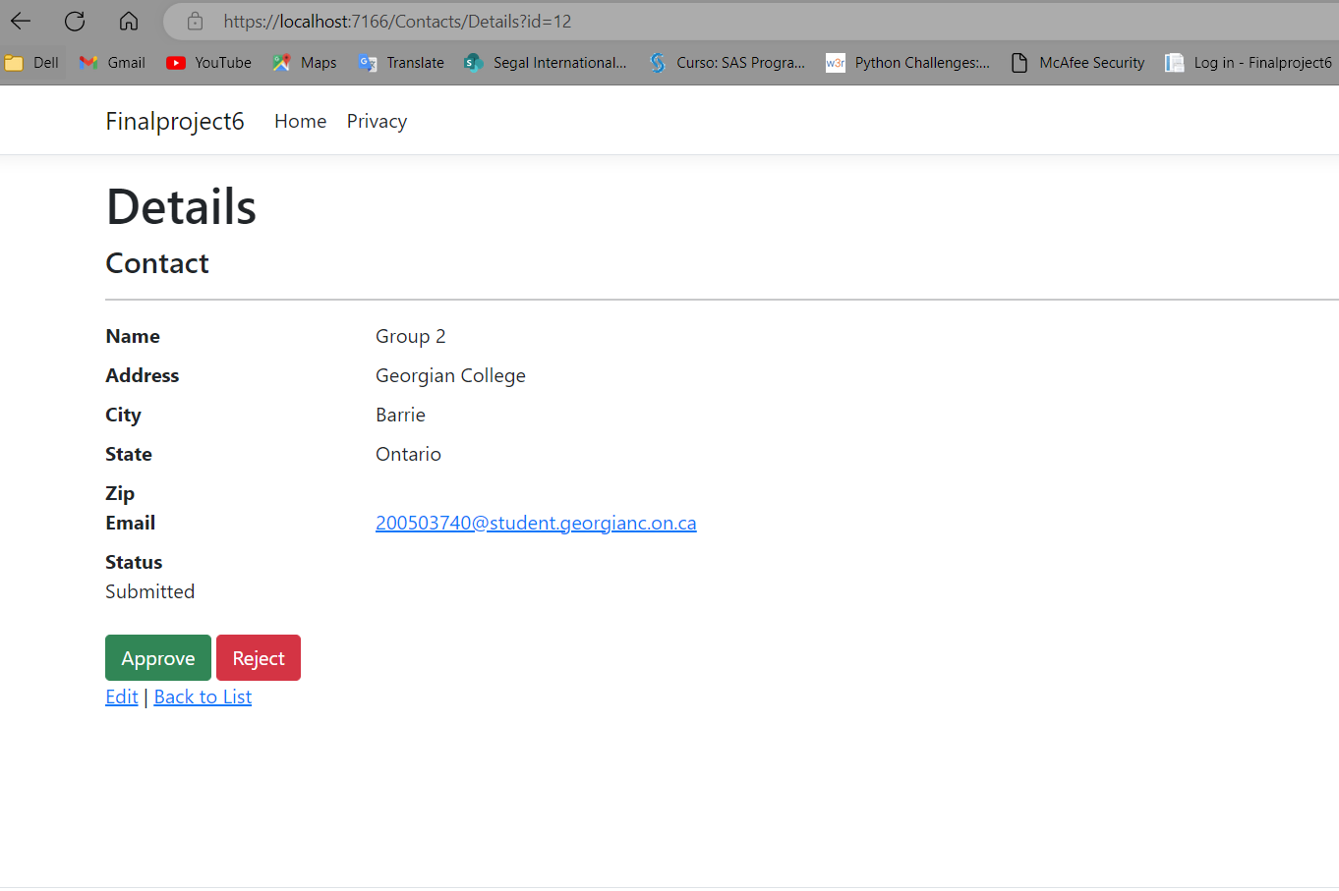
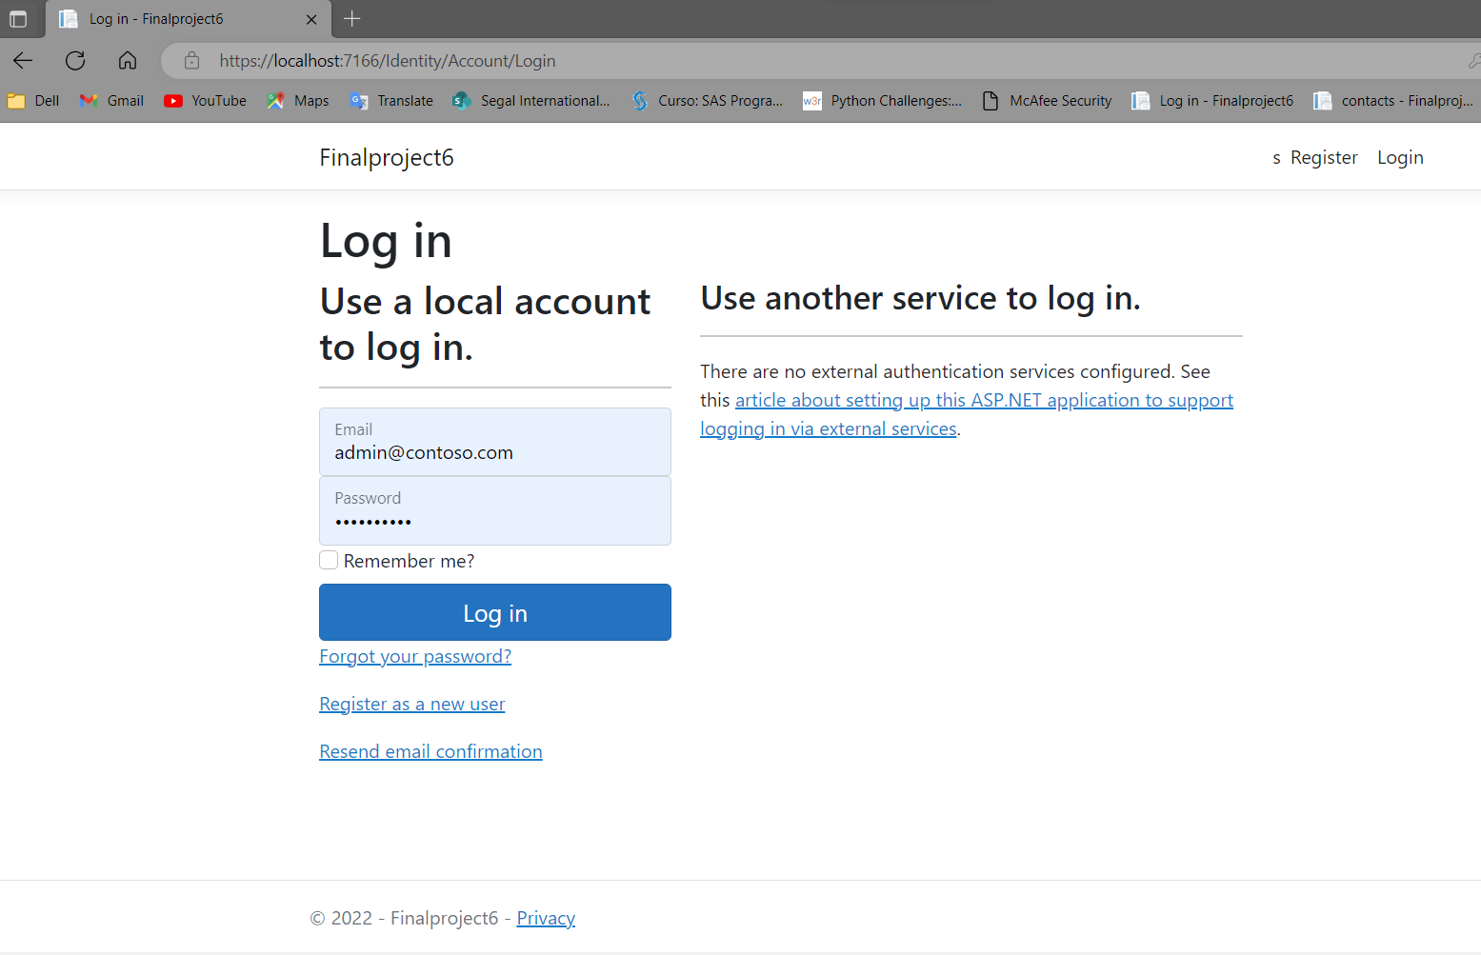
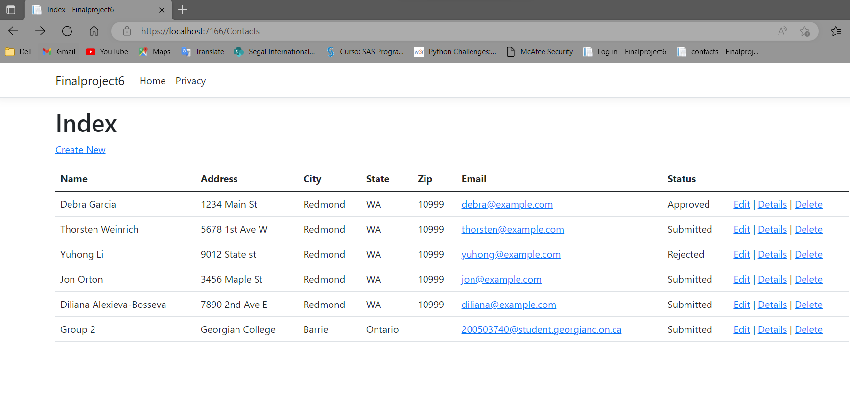
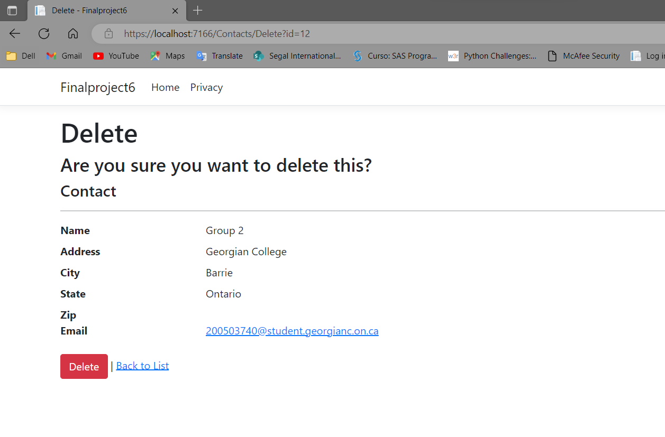
1
Administrators
3. Approve/reject data
1. Login:
2. Index Page
4. Edit/delete all data.

Slide 6
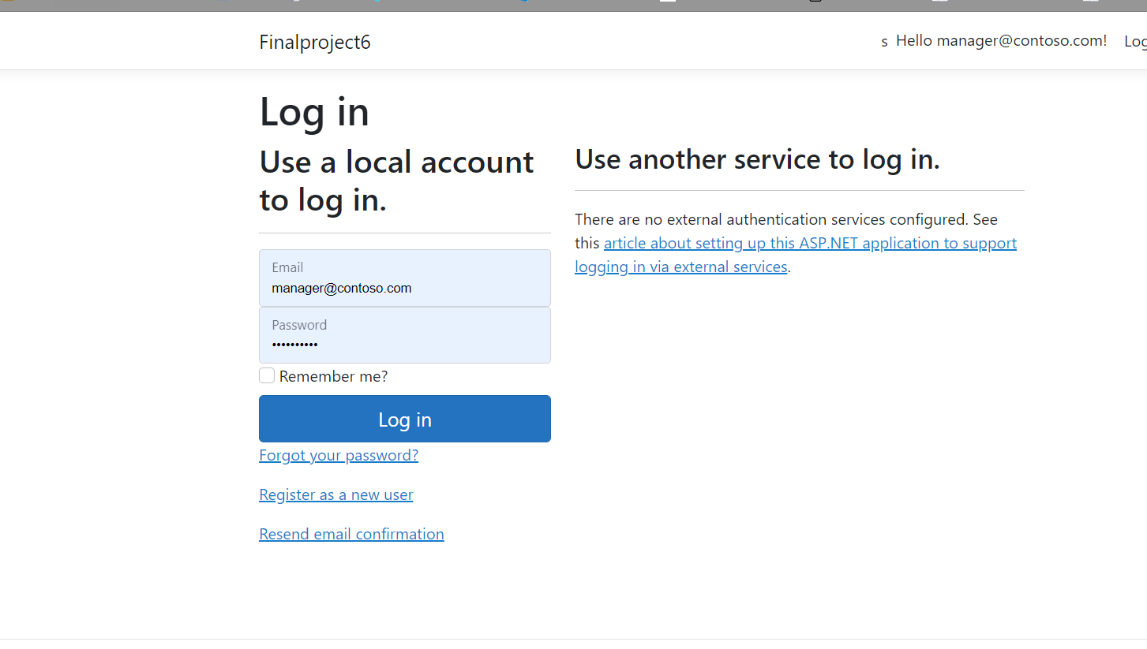
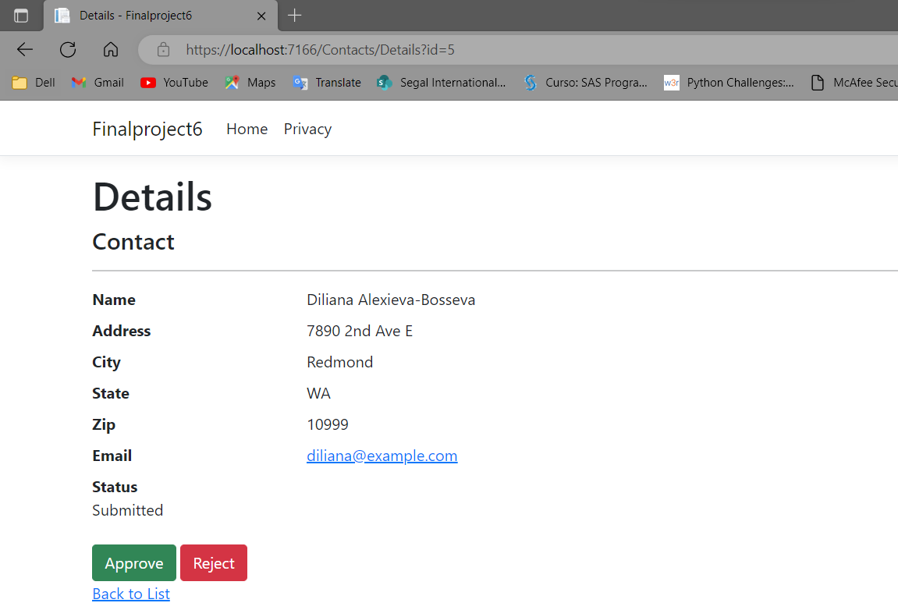
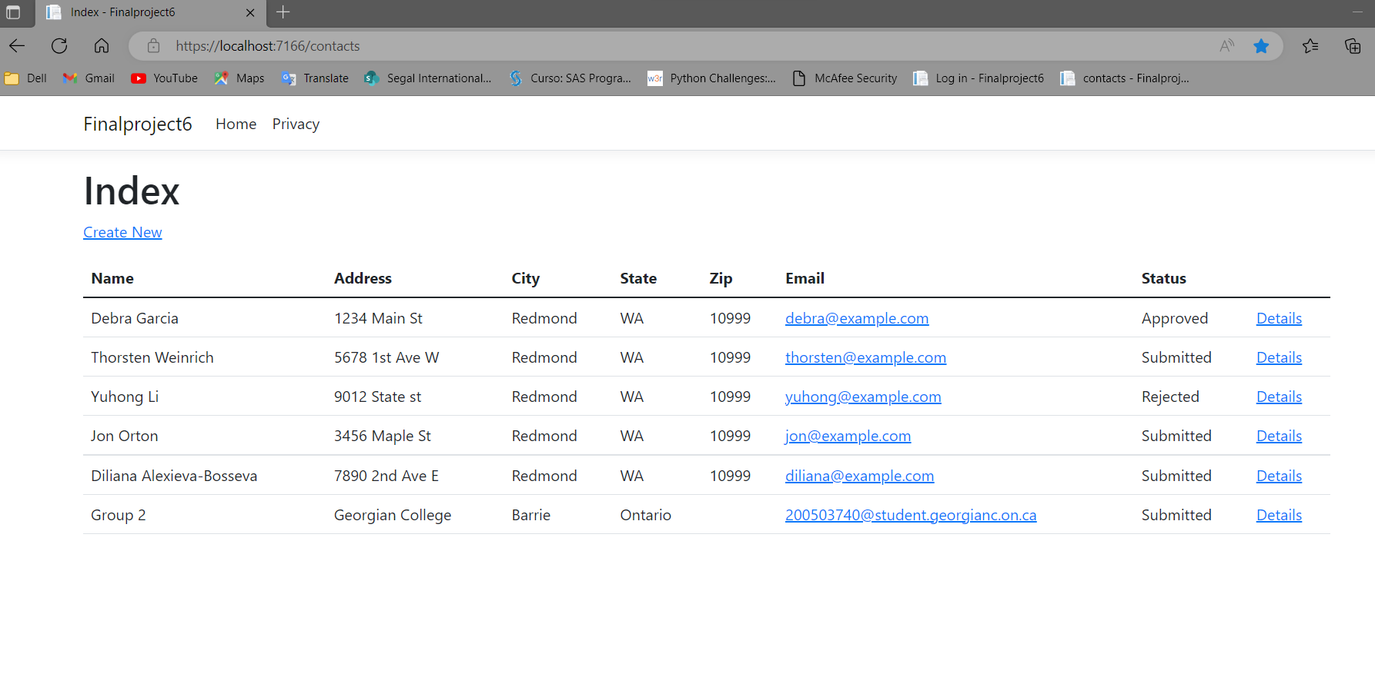
2
Managers
1. Login:
3. Approve/reject data
2. Index Page

Slide 7
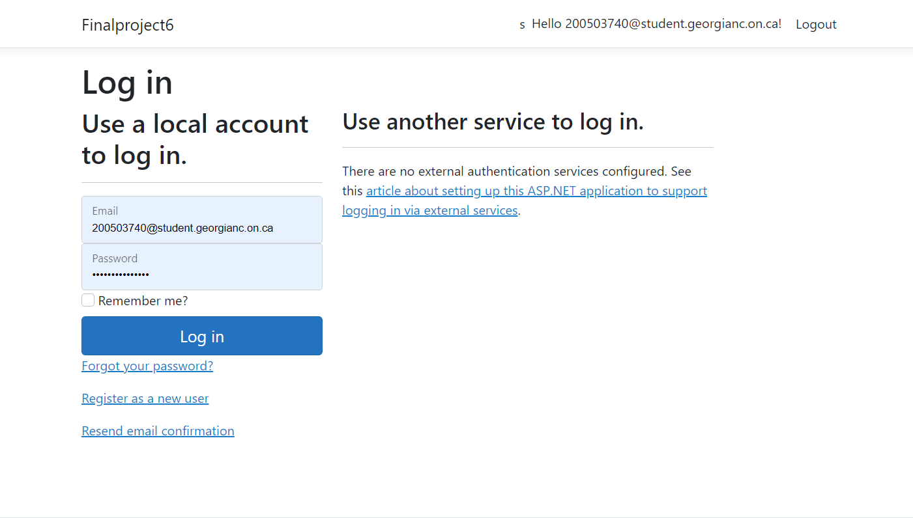
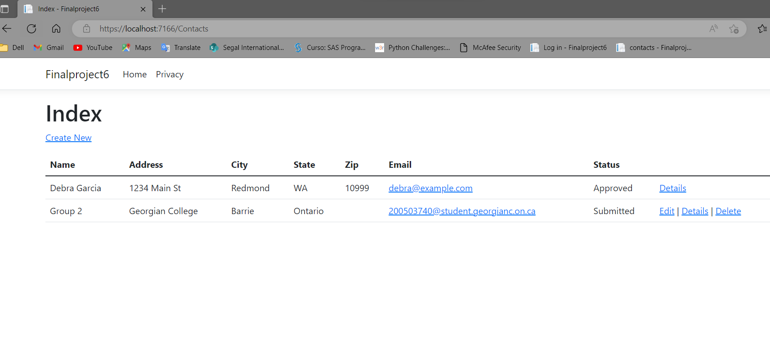
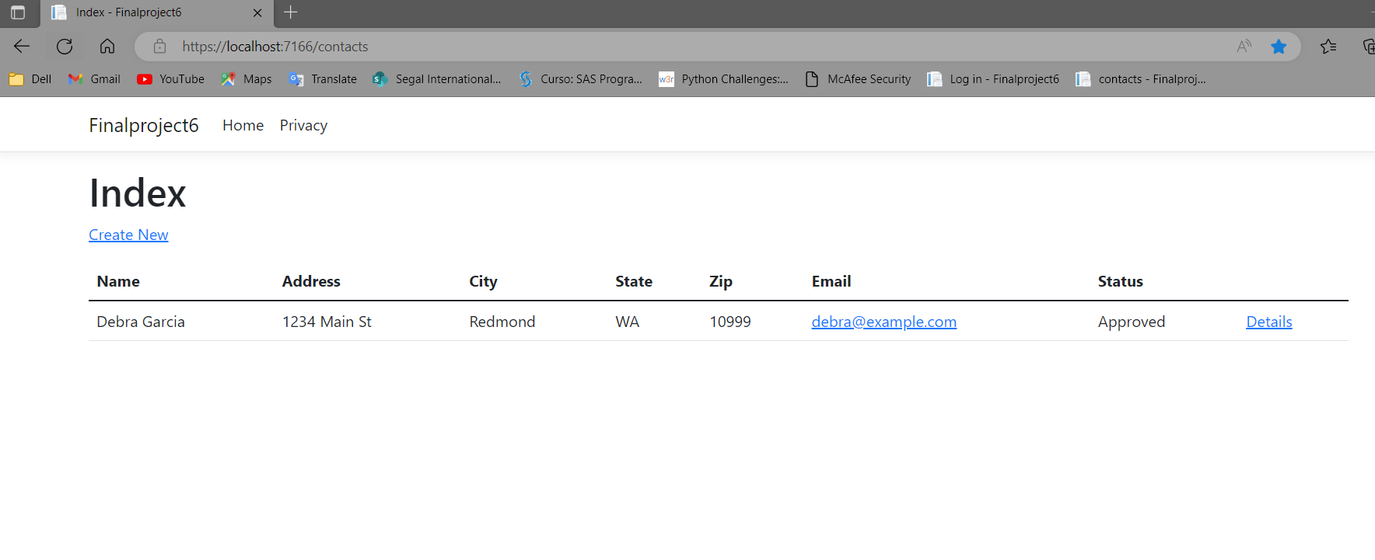
3
Registered users
1. Login:
3. Edit/delete their own data
2. Index Page
Can view all the approved contact data

Slide 8
Part 2: Security Technologies Recommendations

Slide 9
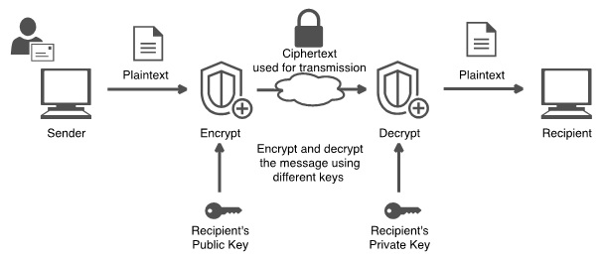
1. How can we transfer personal data securely within their network?
All users with internet access can now exchange work or personal information more easily. however, if this information is not transmitted securely it may result in a breach of privacy. Now, there are many tools available to help protect and secure data transfer.
In a company, one of the best ways to protect confidential data is Email Encryption, there are numerous providers with a guarantee of secure data transport.
Email encryption is encryption of email messages to protect the content from being read by entities other than the intended recipients. Email encryption may also include authentication.
Allowing through the web that the recipient receives a link and logs into a secure email server to be able to access the message and files received

Slide 10
2. What security protocol is best for transferring personal files?
The 3 most popular protocols of secure file transfer are:
SFTP
SFTP is a protocol developed by the Internet Engineering Task Force (IETF) and is perhaps the most common file transfer protocol in use today. SFTP is built on Secure Shell cryptography to encrypt data being transferred.
This encryption is done in part by transferring information in packets as opposed to plain text, which generally leads to faster transmission times when compared to FTP.
Security protocols
FTPS
AS2

Slide 11

3. Can we encode and encrypt images?
Same how software encrypts Text, an image can also be encrypted, By running a sequence of mathematical operations, called an algorithm, on the binary data that comprises an image, encryption software changes the values of the numbers in a predictable way.
The encryption code can only be decrypted using a software key, which is generated by the same program that scrambles the image.
The recipient receives the encrypted image and the key separately. The encoded image is decoded using the software key, which is typically a form of password, which is entered into decryption software.

Slide 12

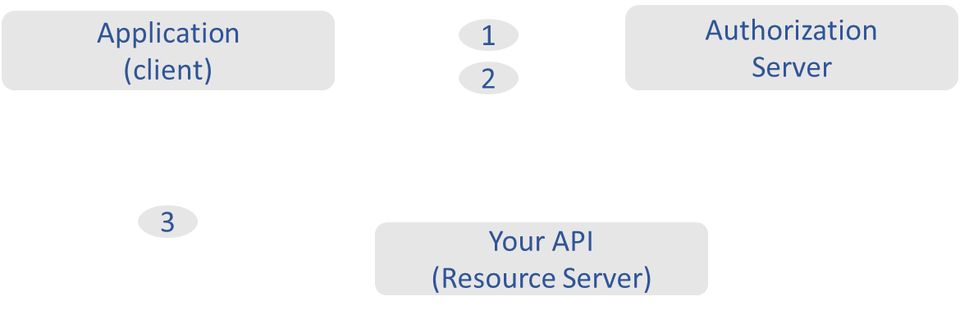
4. Our database cannot be moved from the site, and we need to be able to access it externally using a secure API. Can you explain the architecture of a secure API?
The architecture of a secure API would be as The following diagram shows how a JWT is obtained and used to access APIs or resources:
1
2
3
1
The application or client requests authorization to the authorization server. This is performed through one of the different authorization flows. For example, a typical OpenID Connect compliant web application will go through the /oauth/authorize endpoint using the authorization code flow.
When the authorization is granted, the authorization server returns an access token to the application.
The application uses the access token to access a protected resource (like an API).
2
3

Slide 13

5. Can you recommend a secure framework for coding an API?
ASP.NET Core:
Authentication and authorization are built into ASP.NET Core in the form of ASP.NET Identity. Identity provides a robust authentication system that can use a username and password with a database or external providers such as Facebook, Google, and others.
An especially impressive feature of ASP.NET Core is the Data Protection API. This API gives developers an excellent abstraction for encrypting data at rest. You simply instantiate an instance of a data protection provider and ask it to protect your data.

Slide 14

6. What data interchange format should we use while transferring data between locations?
JSON is the leading data interchange format for web applications and more.
Developers also discovered that JSON was very flexible: you could add, remove, and update fields ad hoc. (That flexibility came at the cost of safety, which was later addressed with the JSON schema.)

Slide 15
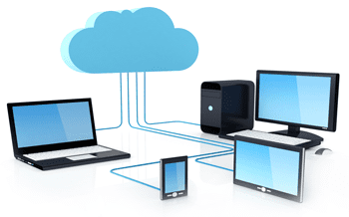
7. How should we store our data in our many locations?
Storing Data across local servers in each location connected to the cloud (multiple of chosen cloud servers for redundancy)

Slide 16
8. What are the ethical concerns related to the transmission of personal data?
Ethical concerns related to transmission of personal data are privacy breach.
Venus has a beautiful name and is the second planet from the Sun
That the companies that have access to their data are transparent in their transactions.
That when they give consent to use/access their data that they are fully made aware of the usage of their personal information.
Individuals want to trust that they own their own data.

Slide 17

THANK YOU !
Does anyone have any question?
addyouremail@freepik.com

